Slide 1
Video 1: The 10,000-Foot View of the Data Storage Landscape
In this video we’ll step back and summarize many of the previous lessons in order to understand the “micro” and “macro” considerations that must fit together in a data architecture.
Agenda:
Current Data Storage Landscape Factors
Reconciling the Operational & Analytical needs across Technology Types

Slide 2
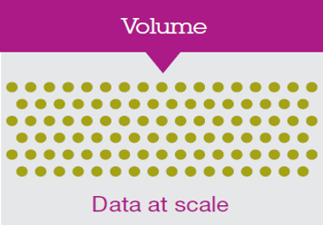
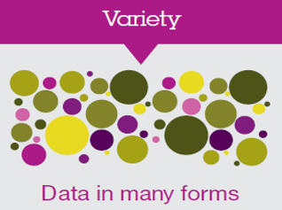

Data Storage Landscape
Transactional Databases
Data Warehouses
Relational Databases

Slide 3
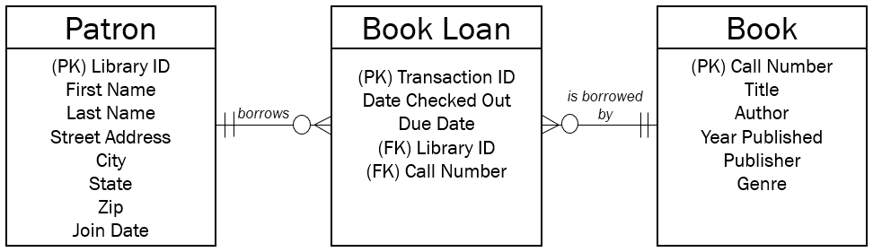

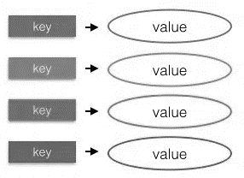
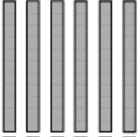
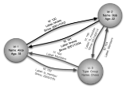
Data Storage Landscape
Operational Needs
Relational Database Model
Transactional Databases
Data Warehouses
Relational Databases
Document Store
Key/Value Store
Data Lakes
Non-Relational Technologies
Alternative Data Stores
Column Store
Graph Store

Slide 4
Data Storage Landscape
Operational Needs
Analytical Needs
Transactional Databases
Data Warehouses
Relational Databases
Data Lakes
Non-Relational Technologies
Alternative Data Stores

Slide 5
Data Storage Landscape
Operational Needs
Analytical Needs
Transactional Databases
Data Warehouses
Relational Databases
Data Lakes
Non-Relational Technologies
Alternative Data Stores

Slide 6
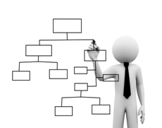
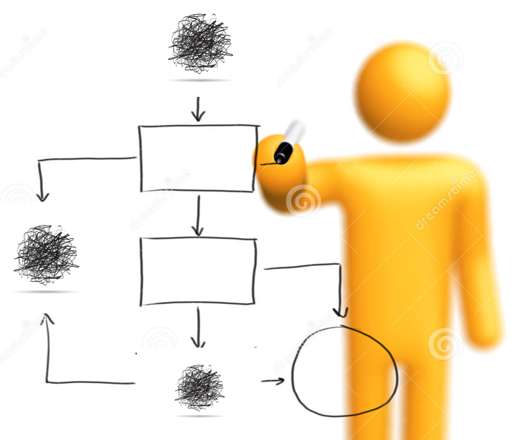
Data Storage Landscape
Operational Needs
Analytical Needs
Transactional Databases
Data Warehouses
Relational Databases
Structure!
Data Lakes
Non-Relational Technologies
Alternative Data Stores
Structure?

Slide 7
Video 2: Challenges of Schema-on-Read
We’ll start out be reviewing and summarizing the nature of the differences between schema-on-read and schema-on-write. Next, we’ll talk about the inherent limitations of not knowing the structure of data while it’s being ingested. Specifically, we’ll consider the problems with access control and compliance with data laws.
Agenda:
Schema-on-Read vs. Schema-on-Write
Access Control
Legal Compliance

Slide 8
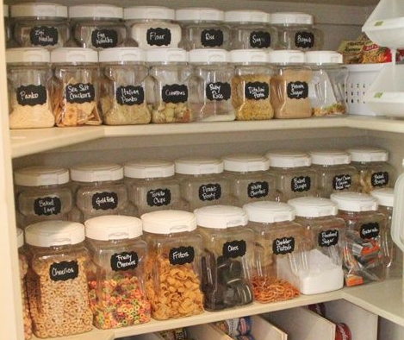
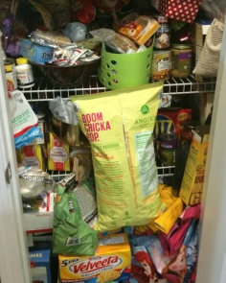
Data Storage Landscape
Apply Schema
Write Data
Collect Data
Relational Databases
Analyze Data
Apply Schema
Write Data
Apply Schema
SOME Non-Relational Technologies
Apply Schema

Slide 9
Data Storage Landscape
Schema on Write
Apply Schema
Write Data
Collect Data
Relational Databases
Analyze Data
Schema on Read
Write Data
Apply Schema
SOME Non-Relational Technologies
Apply Schema
Apply Schema

Slide 10

Schema-on-Read Challenges
Controlling Access to Info in Database

Slide 11
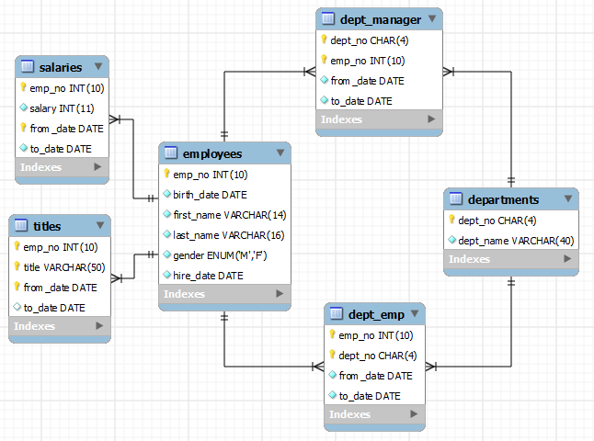
Permissions in a Relational DB
Access Control
-Users
-Roles
HR role is the only role allowed to see the salary table
Only a select few users can see the PII columns in the employee table.

Slide 12



Permissions in alternate data models…
Access Control?
-Users (usually)
-Roles (sometimes)

Slide 13
Permissions in alternate data models…
Access Control?
-What’s in there?!
{
“libraryID”: “723783”,
“firstName”: “Abdul”,
“lastName”: “Koil”,
“email”: “abk@gmail.com”
…other attributes…
}
{
“libraryID”: “723820”,
“firstName”: “Adam”,
“lastName”: “Andrews”,
“SSN”: “123-44-5656”
…other attributes…
}

Slide 14

Schema-on-Read Challenges
Controlling Access to Info in Database
Compliance with Changing Data Laws

Slide 15

Security and Legal Compliance
Laws and Security?
-What’s in there?!

Slide 16
Video 3: Primer on the Current Legal Environment of Data Storage
In order to understand the concerns of potential data architecture limitations surrounding legal compliance and access control, we need to know more about what the current legal situation is.
Agenda:
FIPPS
GDPR

Slide 17
Privacy Policies: US-based Best Practices?
Fair Information Practice Principles (FIPPS)
5 Point Summary…

Slide 18


Fair Information Practice Principles (FIPPS)
Purpose Specification (Transparency)
Why are you collecting this?
Why are you allowed to collect this PII?
Data Integrity (Info Protection)
Properly label (especially PII)
Develop security protocols

Slide 19


Fair Information Practice Principles (FIPPS)
Choice
Can people decline?
Opt-in or Opt-out design
Information Review and Correction
Allow customers to view and correct errors and inaccuracies.

Slide 20
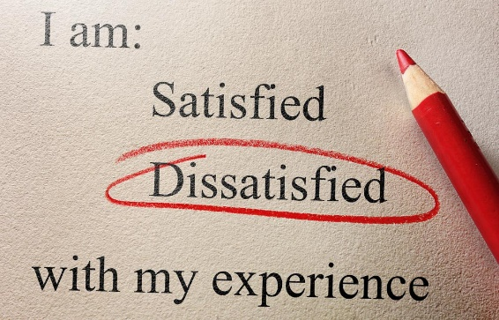
Fair Information Practice Principles (FIPPS)
Accountability / Enforcement
What is the plan to enforce the FIPP?
How are customer complaints handled?

Slide 21

E.U. Privacy: General Data Protection Regs
Passed in April 2016, effective 2018
Massive fines, up to 4% of revenues
Includes:
Right to be Forgotten
E.U.- U.S. Privacy Shield

Slide 22

E.U.’s GDPR: Right to be Forgotten
An individual can opt to remove
negative information from
the internet
Points towards the legal trend of giving people the right to review and remove their personal information

Slide 23

EU-US Privacy Shield
Want to keep data about EU citizens in your US-based data storage solution?
Self-certify that you’re keeping up with EU laws, because the US isn’t currently stringent enough.
Bottom line – you need to know what your data is, where it is, and how you’ll manage it and delete it if necessary.

Slide 24
Video 4: Creating User Access with a Data Analytics Platform
Given the challenges of schema-on-read data solutions, it’s not surprising there’s a host of new tools on the market to help wrangle unstructured data and create a more universal way for different groups within an organization to use the data. We’ll explain and define the benefit of a Data Analytics Platform.
Agenda:
FIPPS
GDPR

Slide 25




Analytics Platform Infrastructure
Data
Users
Transactional Data
Legacy Systems
Batch or Direct Data Streams

Slide 26



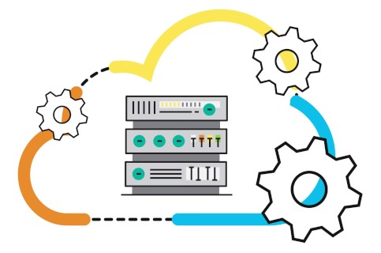


Analytics Platform Infrastructure
Enterprise Cloud Service
Data Ingestion
Transactional Data
Unifying Data Service
Legacy Systems
Batch or Direct Data Streams

Slide 27
Analytics Platform Infrastructure
Enterprise Cloud Service
Curated
Data Ingestion
Meta-Data Management
Transactional Data
Unifying Data Service
Analytics Platform
Data Science Workspace
Legacy Systems
Batch or Direct Data Streams

Slide 28

Analytics Platform Infrastructure
Enterprise Cloud Service
Curated
Data Ingestion
Meta-Data Management
Transactional Data
Unifying Data Service
Analytics Platform
Data Science Workspace
Legacy Systems
Batch or Direct Data Streams

Slide 29

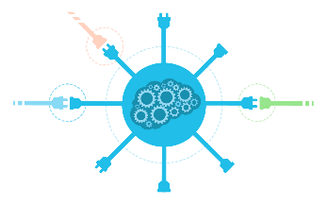


Analytics Platform Infrastructure
Enterprise Cloud Service
Curated
Data Ingestion
Meta-Data Management
Transactional Data
Unifying Data Service
Analytics Platform
Data Scienc Workspace
Direct Access
Legacy Systems
APIs
Batch or Direct Data Streams
BI Tools

Slide 30
Analytics Platform Infrastructure
Enterprise Cloud Service
Legacy System
Data Ingestion
Transactional Data
Unifying Data Service
Specialized Solution
Direct Access
Legacy Systems
Analytics Platform
Data Science Workspace
APIs
Batch or Direct Data Streams
BI Tools

